Slide 1

Correlating Mobility and Covid Impact in the US, UK, and Japan
A visual comparison between mobility changes and infection numbers

Slide 2
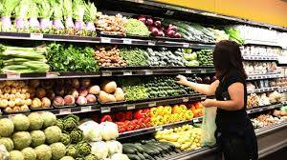
Problem statement:
What mobility factors are most correlated to COVID impact?
Mobility factor can be categorized in various ways. We will look at local mobility changes towards
Grocery stores and pharmacies
Parks
Residential areas
Workplaces
Transit stations

Slide 3


Reasoning
Separating mobility factors and determining each one’s impact towards COVID 19 can bring about more efficient actions towards limiting COVID spread.

Slide 4

Methods
Clean the data
Sort the data
Aggregate all deaths and cases per day in each country
Organize into proper csv file
Apply linear regression
Deaths
Cases
Each mobility trait
Qualitatively interpret data

Slide 5
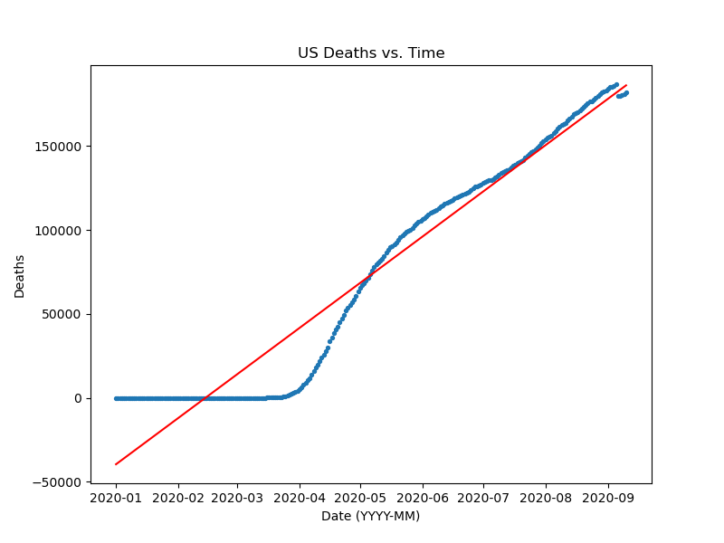
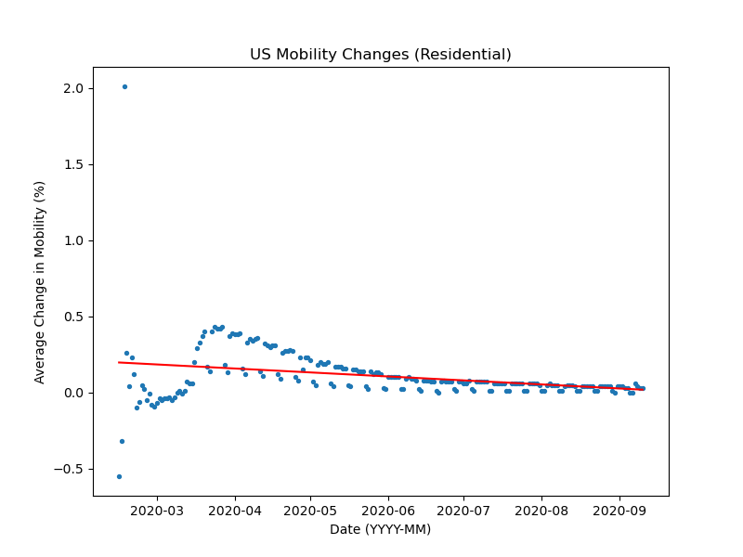
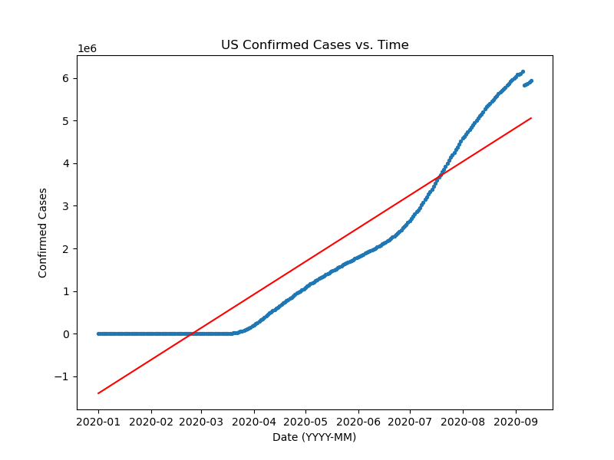
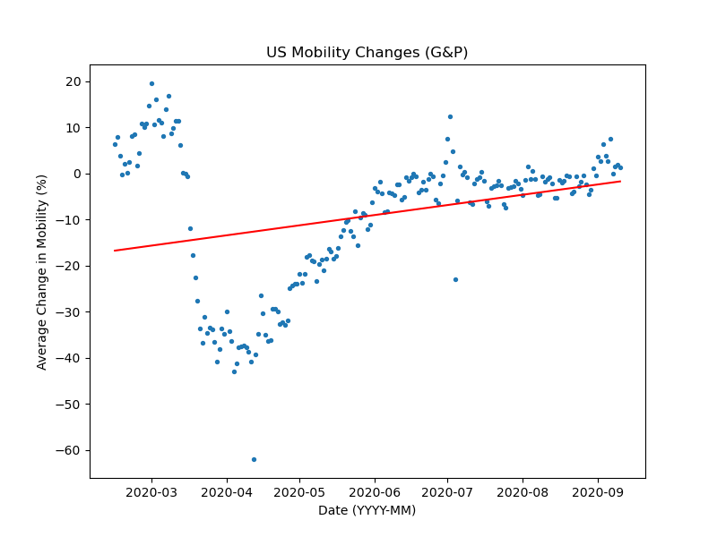
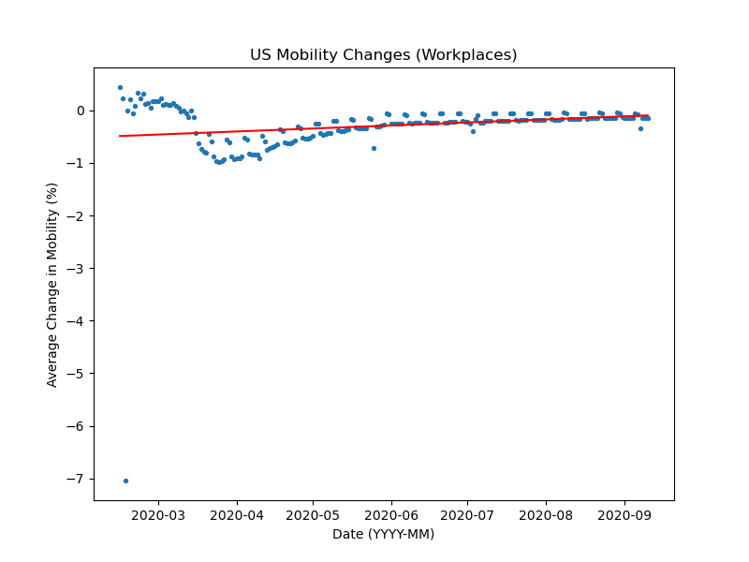
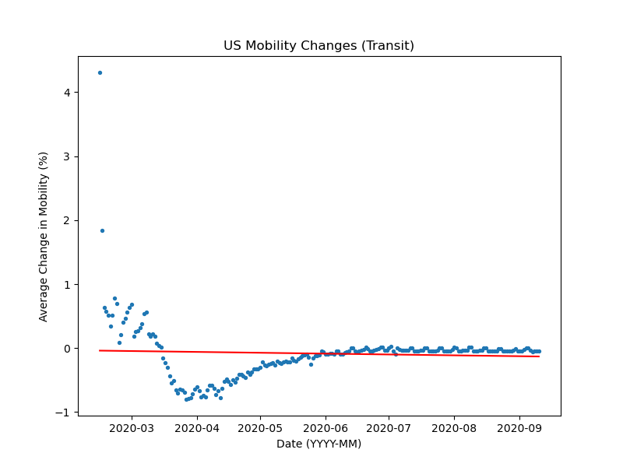
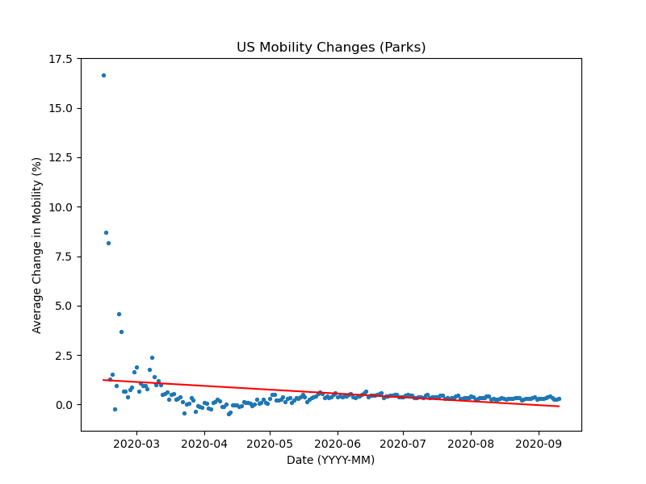
Visualizations:
US
https://github.com/danielsjoo/DS-hackathon-2020/tree/master/figures

Slide 6
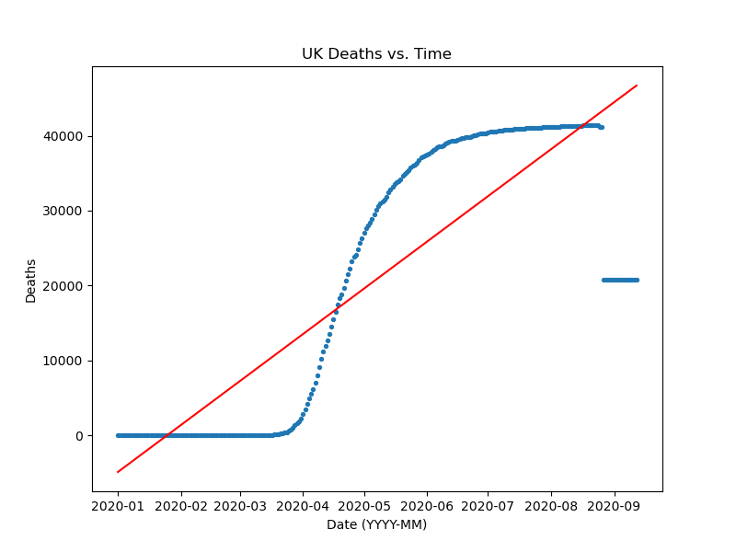
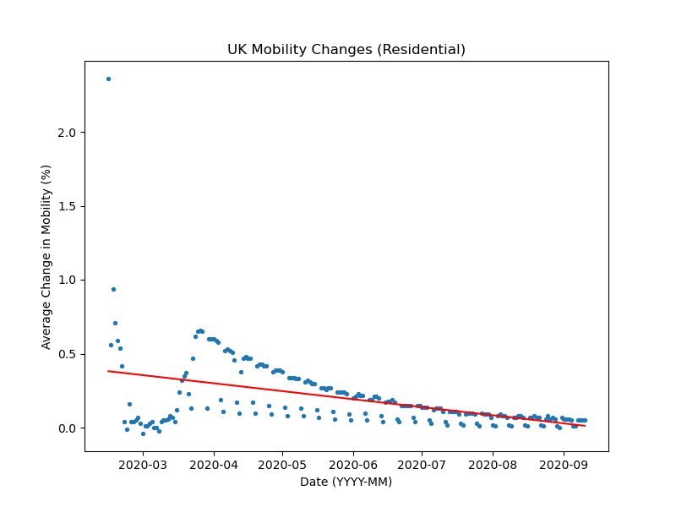
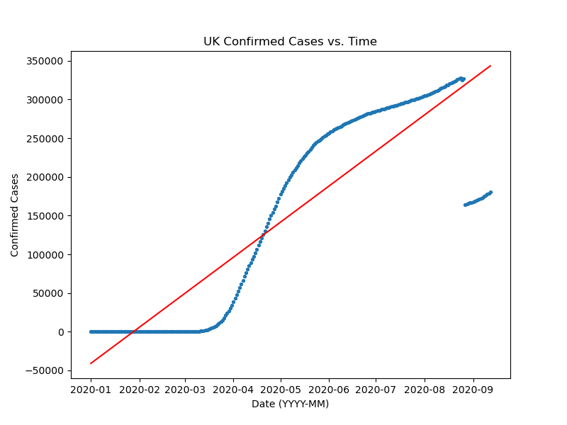
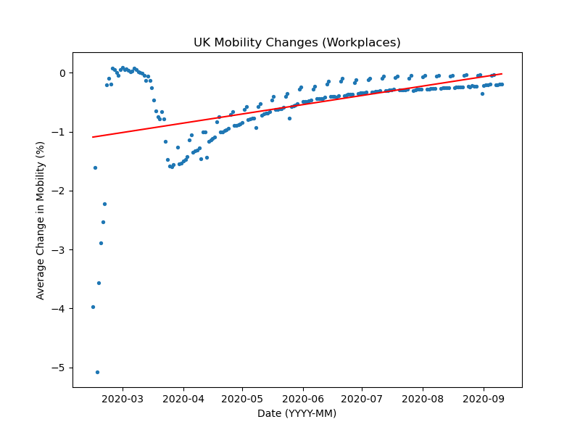
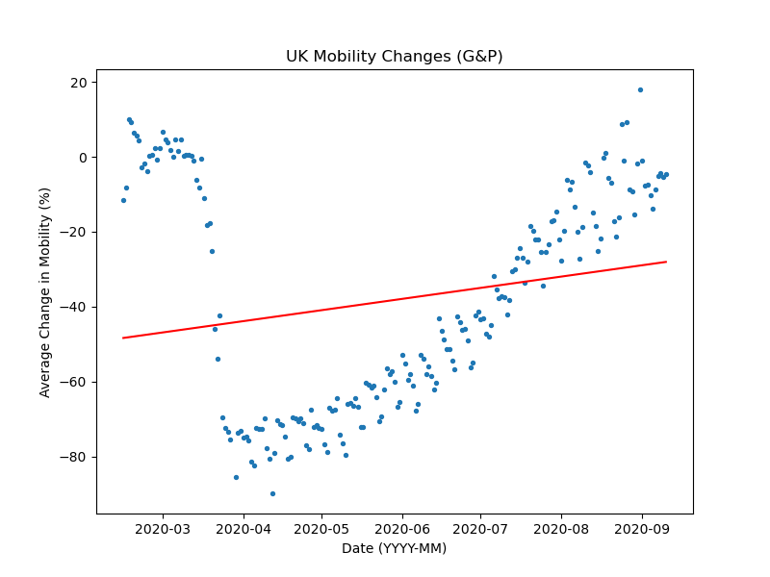
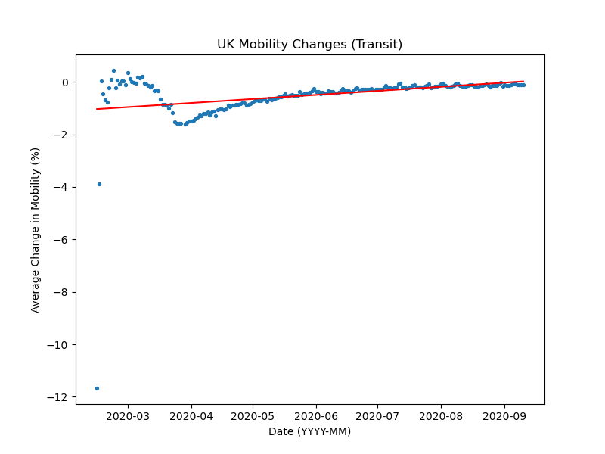
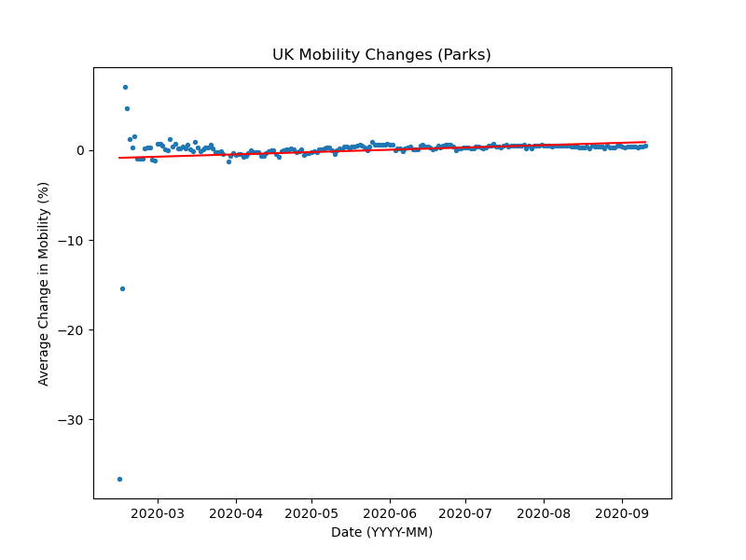
Visualizations: UK
https://github.com/danielsjoo/DS-hackathon-2020/tree/master/figures

Slide 7
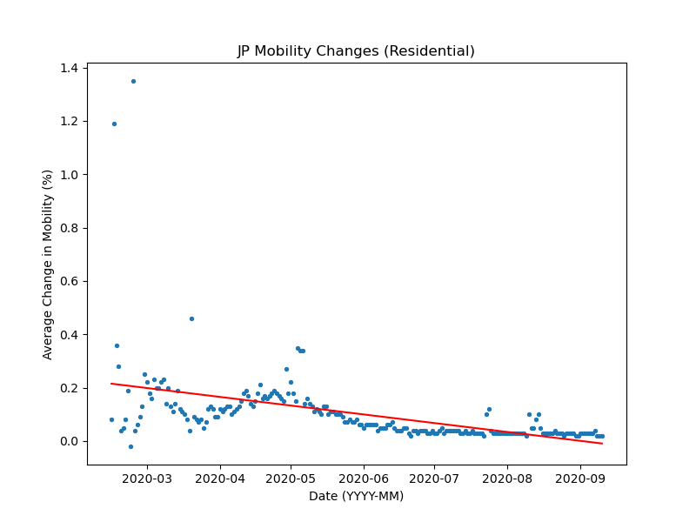
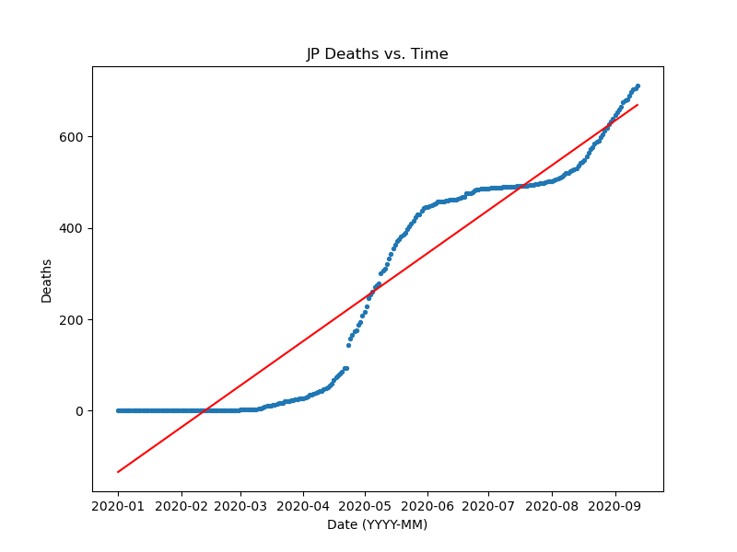
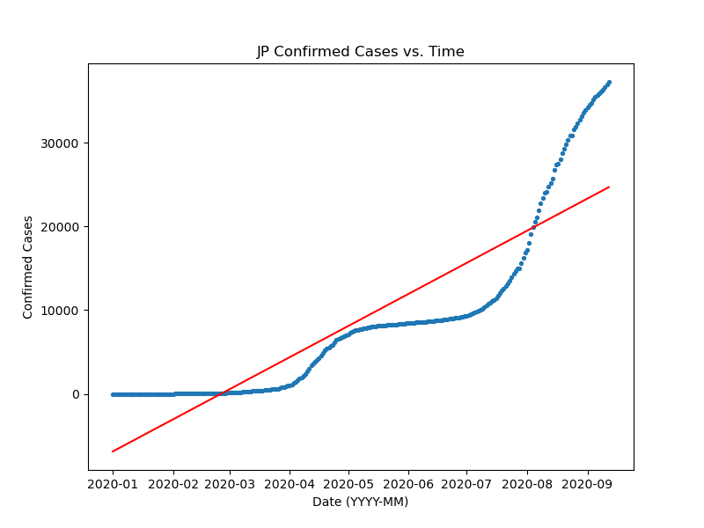
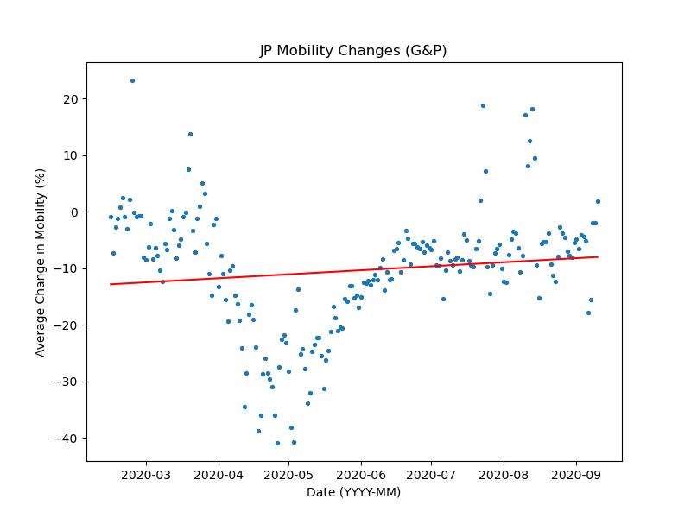
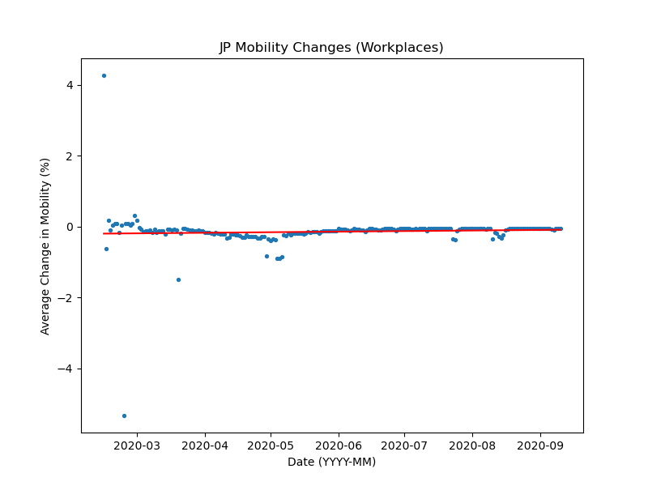
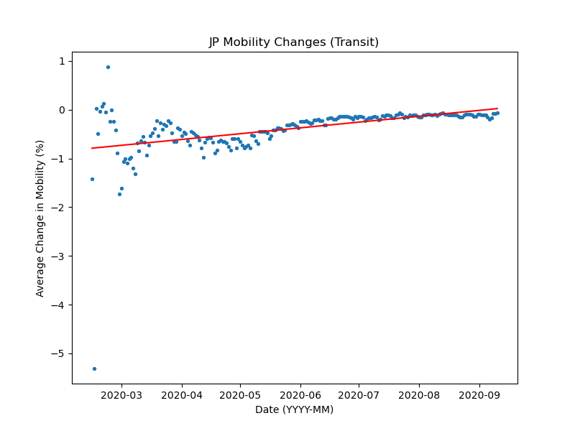
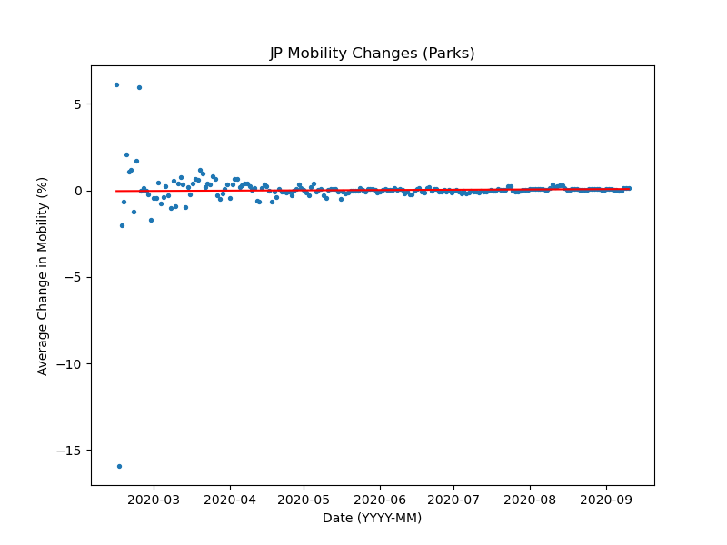
Visualizations:
JP
https://github.com/danielsjoo/DS-hackathon-2020/tree/master/figures

Slide 8
Overview
These data generally have two inflection points, at different times depending on the country.
The mobility changes seem to indicate the rapid shifts in social behavior following early reports of the first infections of the country
E.g. US cases begin early April, when mobility changes in groceries and pharmacies are lowest
This agrees with the narrative that people quickly responded to the threat of covid and loosened their attitudes as times passed.
Parks generally had a low change in mobility.
We also found that a lot of our metrics were not, in fact, linear
Unfortunate realization made after regression was performed

Slide 9
Conclusions:
What can we do with these data?
In all honesty, much more analysis needs to be done, but this is a helpful starting point to visualize the data
We learned that it’s helpful to understand the shape of the data before we start analyzing
Contrary to our initial goals, we cannot yet confidently determine the mobility changes that most efficiently decrease covid impact.
We became more familiar with powerful data science skills
Project management, version control software, synchronous programming, Scikit Learn

Slide 10
Resources
Python 3
VSCode
Github
https://github.com/danielsjoo/DS-hackathon-2020.git
Scikit Learn
Numpy
Pandas
Matplotlib
Excel
BigQuery
Google images
Time that we can never get back

Slide 11

Next steps
Try algorithms that are not linear regression
Apply PCA on all the different parameters and see if there is interesting clustering
We could also look at Oxford’s policy tracker to correlate government stringency on different mobility factors.
https://www.google.com/aclk?sa=l&ai=DChcSEwismorrvPfrAhXHnrMKHerTDHQYABAGGgJxbg&sig=AOD64_152TOHWqLnQcwvvnYFEcuzg-5ypA&adurl&ctype=5&ved=2ahUKEwjWvv3qvPfrAhUAQTABHWbnBOYQvhd6BAgBEFs

Slide 12
Thank you (Real talk)
We would like to express our gratitude to both the judges and CDSS for allowing us the opportunity to collaborate on a project like this. Learning how to use popular data science techniques, manage a project, and work with real data has been a real pleasure. Though it was arduous, we had a lot of fun learning from each other.
-Daniel Joo, Aaron Liss, Nathaniel Wang, Daniel Lee, Andrew Tang

